Slide 1

College Placement Analysis
Presented By:
T. Lakshmi Hari Chandana.

Slide 2
Agenda
1. Problem Statement & objective
2.Understanding the Columns
3.Data Information
4.Data Type Conversion
5. Handling Outliers
6.Analysis
7.Insights
8.conclusion

Slide 3
Problem Statement
Predict and analyze the factors affecting student placement in colleges based on academic, cognitive, and skill-based attributes.
Objective
Feature Analysis: Identify which features (IQ, CGPA, communication skills, projects, etc.) have the most significant impact on placement outcomes.
Data Visualization: Explore the data using box plots, histograms, and correlation heatmaps to understand distributions, outliers, and relationships among variables.
Support Decision-Making: Provide actionable insights for colleges and recruiters to enhance student placement strategies.

Slide 4
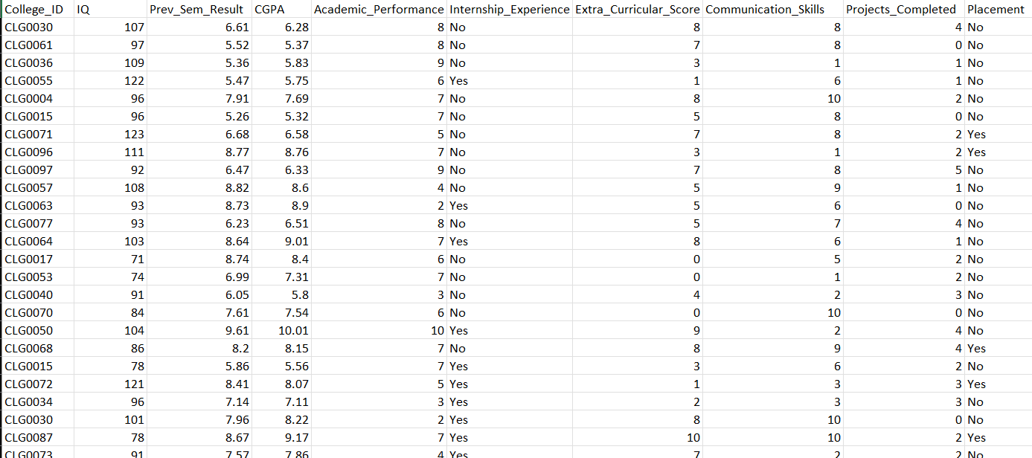
Understanding The Columns

Slide 5
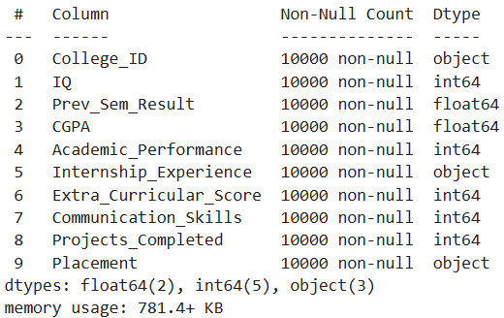
Data Information

Slide 6
As my dataset is cleaned one , there is no duplicates and null data in dataset , so there is no cleaning process except data type conversion

Slide 7
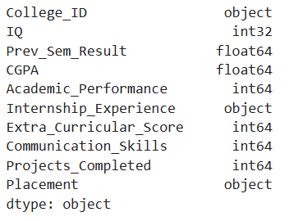
Data Type Conversion
Data type conversion ensures columns are stored in the correct format for accurate analysis.
I had converted IQ column into int because mostly we will say in terms of numeric in general case not in float.

Slide 8
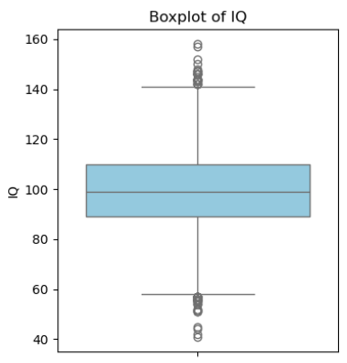
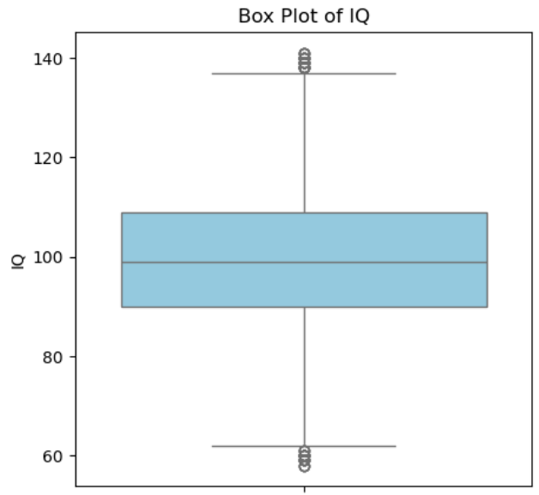
Handling Outliers
Here I handled outliers for some extent ,after checking the distribution it is symmetric so I had came into one conclusion that I have to replace Outliers with median.
Before handling outliers After handling outliers

Slide 9
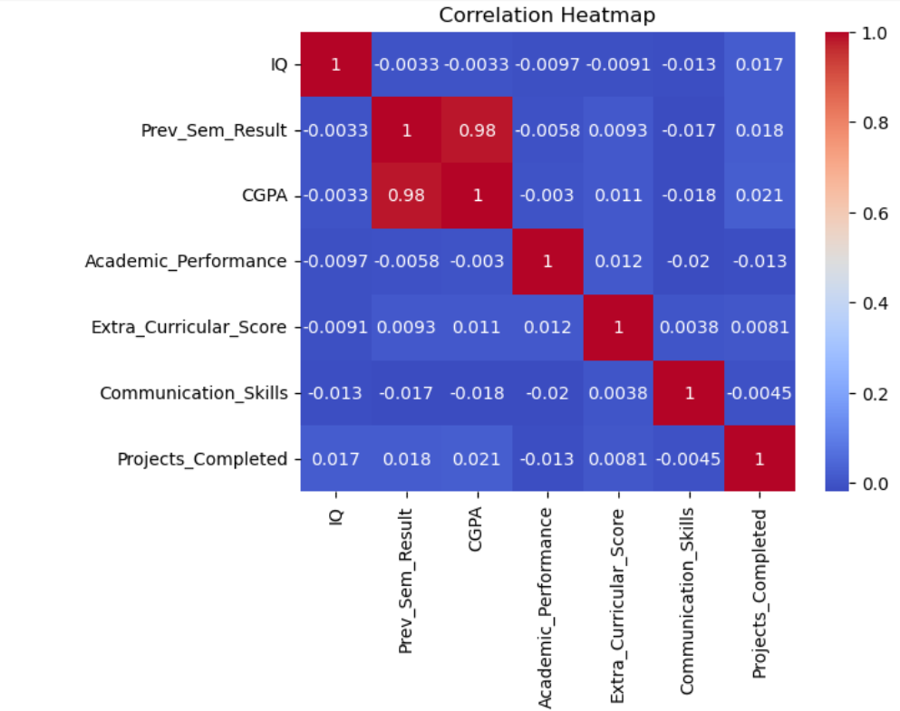
Heat Map Analysis
Most variables show near-zero correlations, with only Prev_Sem_Result and CGPA strongly linked, while IQ and skill/activity features remain independent.

Slide 10
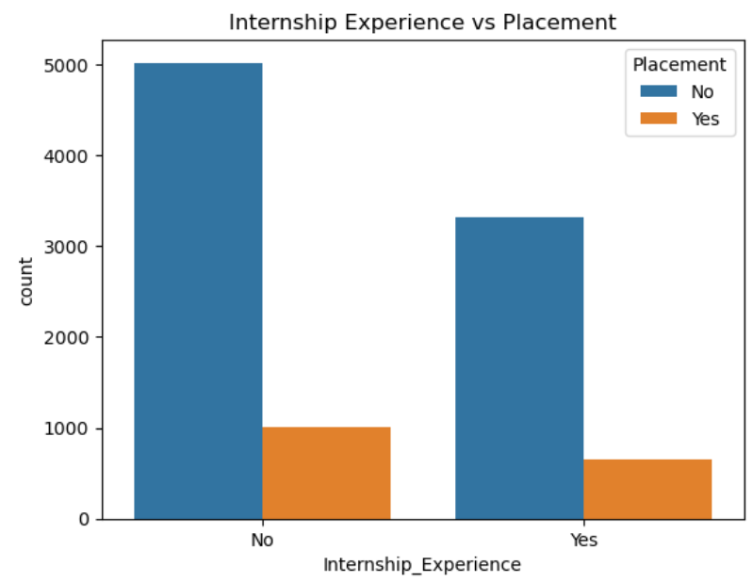
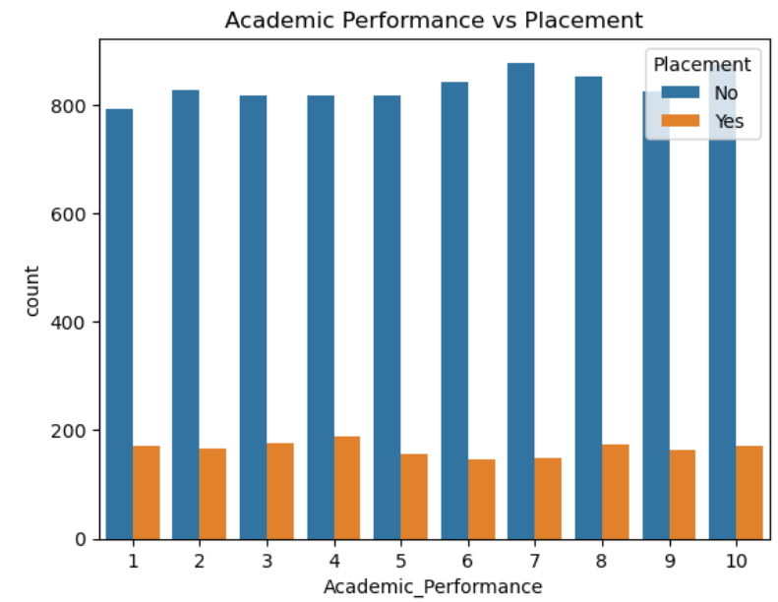
Univariate Analysis
Internship experience emerges as a strong positive factor influencing placement outcomes, highlighting the value of practical exposure in securing job opportunities.

Slide 11
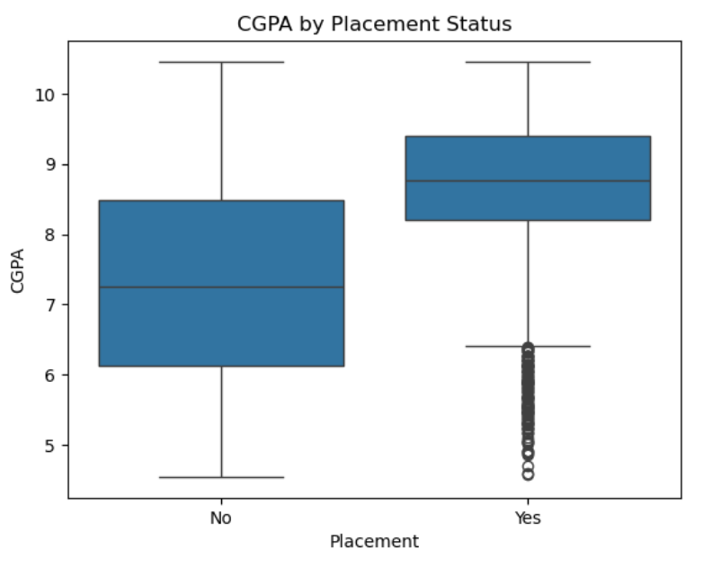
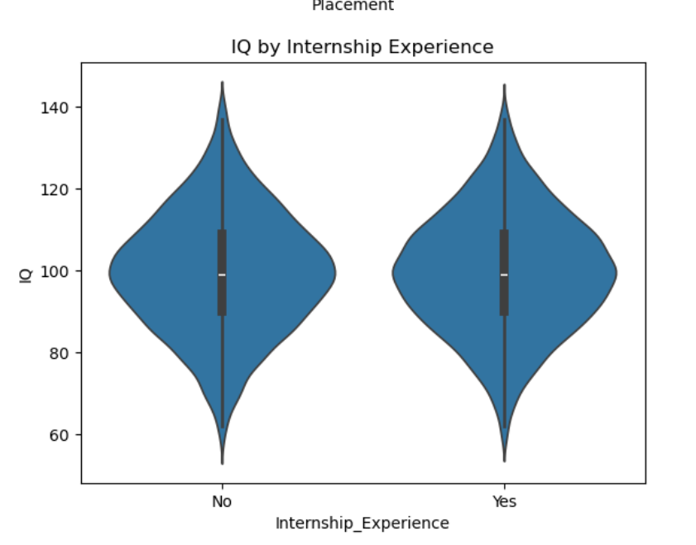
Bivariate Analysis
Students with higher CGPA are more likely to be placed, highlighting the strong role of academic performance in placement success.
IQ levels show little variation across internship experience, suggesting IQ has a limited influence on placements.

Slide 12
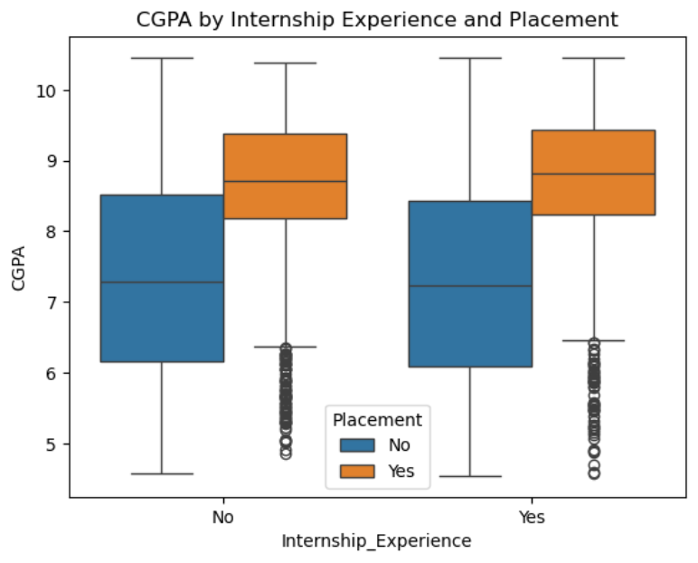
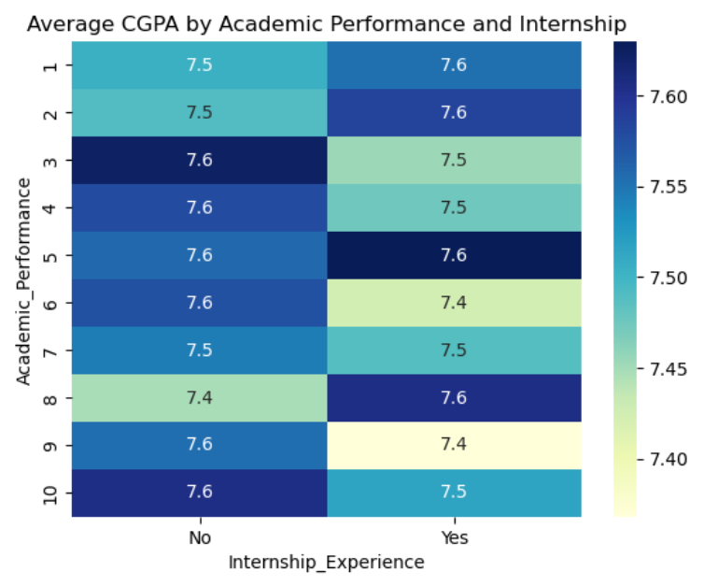
Multivariate Analysis
Students with higher academic performance and internship experience achieve better CGPA and placement results.
This indicates that the blend of strong academics and practical exposure greatly enhances placement opportunities

Slide 13
Insights
Placement Rate:
Only ~16.6% of students are placed — suggesting a competitive or selective placement process.
Internship Correlation (Potential):
Since most students have no internship, this feature might strongly impact placement chances.
Academic vs. CGPA Consistency:
Both Prev _ Sem _ Result and CGPA average around 7.5, showing consistent academic performance across semesters.
Skill Balance:
Both Academic _ Performance and Communication _ Skills center around 5–6, suggesting moderate overall skill levels.
Projects:
Average of 2.5 projects completed per student (max 5). Project completion could correlate with
placement success.
No Data Quality Issues:
No missing values or inconsistent data types detected

Slide 14
Conclusion
The dataset shows that while most students maintain solid academic results, non-academic and practical experiences (like internships, communication skills, and projects) are likely the main differentiators for successful placements.
To improve overall placement rates, colleges should:
Encourage internship participation.
Focus on soft skills training and communication development.
Support hands-on learning through projects and real-world exposure.
In short: Strong academics are necessary but not sufficient — holistic development drives placement success.

Slide 15

THANK YOU

